Slide 1








Mykolaiv
Regional State Administration
Mykolaiv Region is a reliable partner for international cooperation

Slide 2
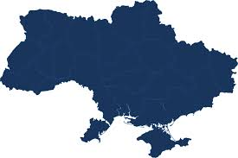
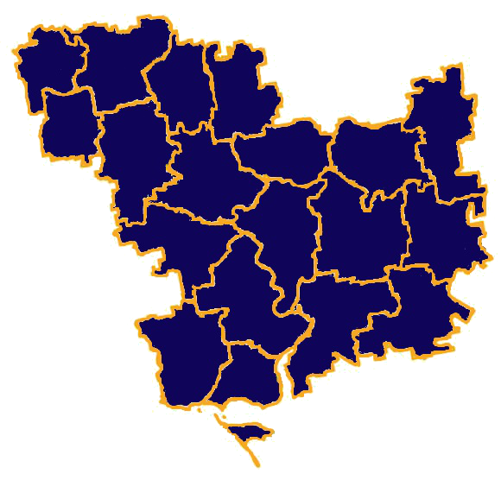
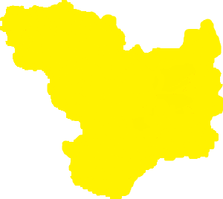
Mykolaiv Region
Total area – 24 600 of km²
Population – 1.12 mln of people
Administrative center – Mykolaiv
Access to the
Black Sea Basin
Regions
which Mykolaiv Region borders on :
Odessa, Kherson, Dnepropetrovsk, Kirovograd

Slide 3
Diversified Economy
Main sectors
of foreign investment
Structure of economy
37,2 %
Agriculture
22 %
Other
Health Care
7 %
Industry
21 %
Industry
3 %
Transport
35,2 %
17,2 %
Construction
7 %
13 %
Trade
2,5 %
Construction
7 %
10 %
Education
and Science
10 %
Transport
Public Management
Wholesale trade

Slide 4






Substantial Scientific Capability and
Highly Skilled Labor Resources
76,8 % (531 500 of people)
economically active population
of employment age
33 000 students
16
VII place ($ 12 mln)
among Ukrainian Regions by
innovation activities expenditures
Higher educational
institutions
(I-IV accreditation levels)
VI place
among Ukrainian Regions
by income per capita

Slide 5
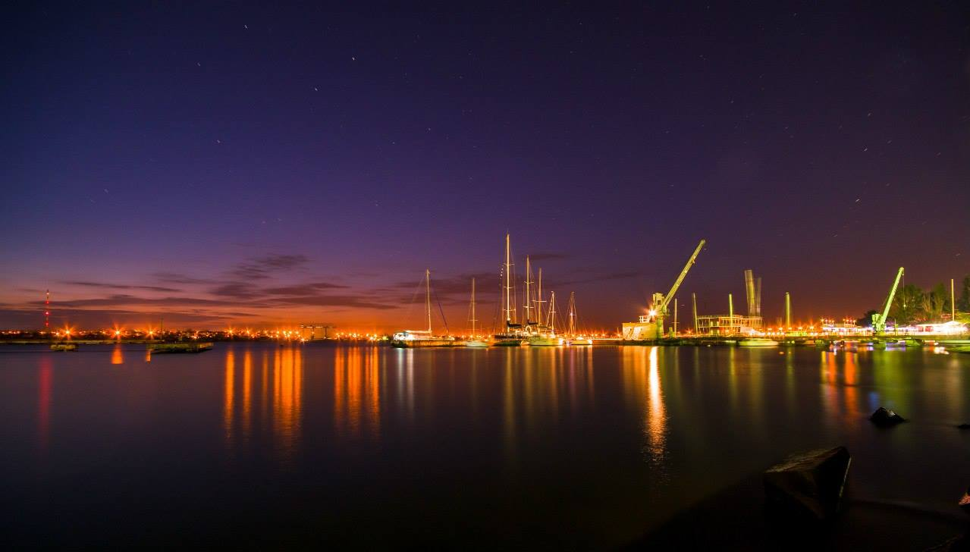







Powerful Production Potential
32 %
Energy
32 %
8 %
Food
Industry
Others
Structure of Industry
1%
Light
industry
15 %
Metallurgy
4 %
Mining
industry
8 %
Engineering

Slide 6
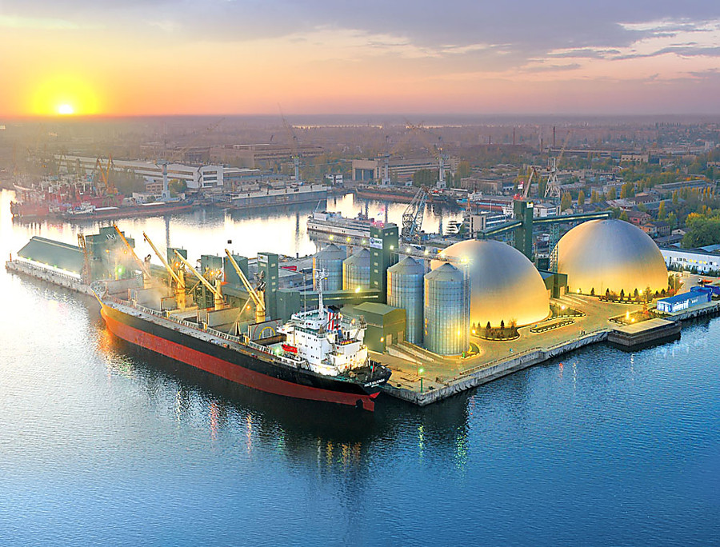

Mykolaiv Region is a leading market of Ukraine
Priorities
for investment
Raw leather
78,6 %
Alumina
100 %
Creation new enterprises and re-equipment existing enterprises in the real sector
of the economy
Construction of own fleet at “Nibulon” Shipyard
Creation of an industrial park
in Mykolaiv
Tomato
paste
53,2%
24,4 %
Juices
Agricultural
machinery
44,0%
100 %
Gas turbines
33,8 %
Condensed milk
and cream

Slide 7


High Energy Potential
Priorities
for investment
16,2 %
of Ukraine
wind power
potential
18,1
bln of kWh
nuclear power
produced
per year
Development
of alternative energy
Construction of the South-Ukraine NPP
№4 power unit
Completion of construction and
commissioning of №3 hydroelectric unit
of Tashlyk pumped storage plant
Construction of spray ponds,
reconstruction of the South-Ukraine NPP
water supply system
52
solar power
plants
(599,5 MW)
32
wind turbines
(94,8 MW )
ENERGY POTENTIAL
OF REGION
300
sunny days
per year
50 %
of Ukraine
solar power
potential

Slide 8







Favorable Climatic Conditions and Fertile Lands for Development of Agrarian Sector
The region produced in 2019 (tons):
Priorities
for investment
3,1 MLN GRAINS
1 MLN SUNFLOWERS
478,3 thousand VEGETABLES
176,8 thousand POTATOES
Development of agricultural production
and agro-processing
Implementation of drip irrigation system
Rehabilitation of water reservoirs
for industrial fish farming

Slide 9
Benefits of Geographical Location
Baltic Sea
International
Transport Routes
Minsk
Berlin
Warsaw
Prague
Kiev
Baltic Sea – Black Sea
Bratislava
Vienna
Mykolaiv Region
Black Sea Economic
Cooperation
Budapest
Odessa
Bucharest
Black Sea
Eurasian
Sofia
Rome

Slide 10




Developed transport infrastructure
and significant transit opportunities
Priorities
for investment
3 sea ports
which are capable
of handling over 40 mln tons
of cargoes per year
Increase of the Buh-Dneprovsky-Lyman
Channel capacity
Dnepr and Southern Buh Rivers
Rehabilitation Investment Program
Construction of bridge over
the Southern Bug River in Mykolaiv
Modernization of “Mykolaiv International
Airport” production capacities
“Mykolaiv
International Airport”
“Kulbakine” Airfield
720 km - railway network
within the region;
800 wagons per day –
“Mykolaiv” transport hub
cargoes handling capacity

Slide 11
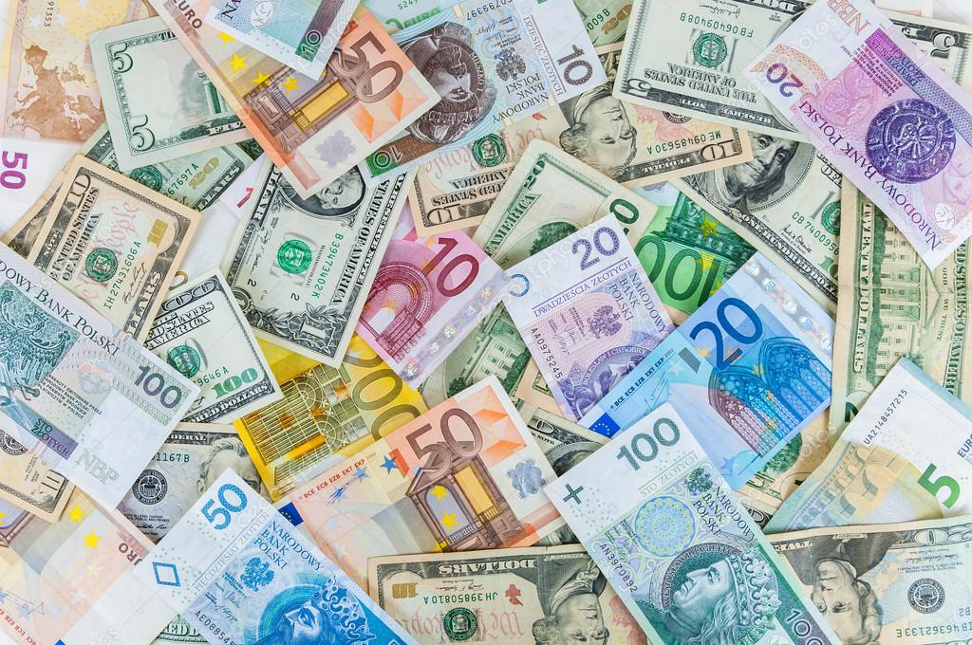





Intensive Foreign Trade Activity
$ 2,3 bln
export
of goods and services
600 enterprises of foreign
trade activity
150 countries
Leadership
in export of grains and
sunflower oil in Ukraine
Successful projects of a worldwide known companies
Positive balance
of a foreign trade
6th rank
in export of goods
in Ukraine
«Bunge» $ 280 млн
«PepsiCo» $ 200 млн
«Posco»
$ 65 млн
«Lactalis»
$ 50 млн
«Cofco»
$ 75 млн
«Dyckerhoff»
$ 56 млн

Slide 12
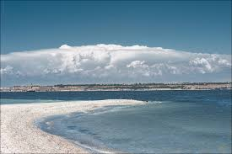
Great Tourist Potential
2 mln m³
of therapeutic
mud
Priorities
for investment
140 km
length of sea
and estuary coastline
Development of local resort on the
territory of Koblevo
United Territorial Community
Development of ecological
and touristic centers within
national nature parks
Construction of health care
center using Tiligul`sky Liman recreation resources
3
resort areas:
Koblevo
Rybakovka
Оchakov
141 objects
of natural reserve fund
with total area of
75 000 ha

Slide 13

Benefits for foreign investors
Exemption from taxation of joint investment income tax
Exemption from taxation of excise tax on electricity produced by the cogeneration facilities using a renewable energy
Exemption from import duties for investors when importing goods for at least
3 years in order to invest under registered agreements
Exemption from import duties for registered industrial parks when importing equipment and components which are not manufactured in Ukraine and are not
an excisable goods
Incentives on land and real estate taxes (are set by the decision of local authorities)
Preferential rates of import duties when importing goods originating from WTO countries or countries Ukraine has signed free trade agreements with
VAT preferential rate (7%) when importing medicines

Slide 14
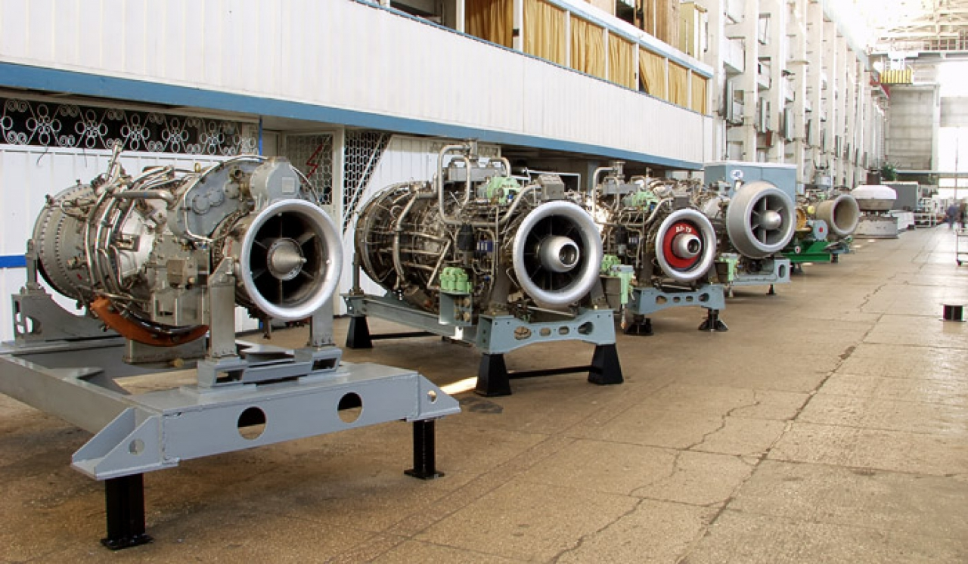
Mykolaiv Region is open to cooperation
To implement investment projects
Industry
More than
700
Agriculture
land plots
Renewable energy
1 1
total
area
thousand
ha
Education and IT technology

Slide 15
Entrepreneurship Support Regional Fund
of Mykolaiv Region www.consult-center.
com.ua
Mykolaiv
City Council
www.mkrada.gov.ua
“Business Support
Center” LLC www.biz.mk.ua
Institutions which support investors:
Mykolaiv Regional
State Administration
www.mk.gov.ua
Mykolaiv Regional
Chamber of Commerce
and Industry
www.rtpp.com.ua
“Mykolaiv Development Agency”
www.mda.mk.ua
Local Development
Agency of Koblevo
United Territorial
Community
www.kamr.org.ua

Slide 16
Mykolaiv Region
is open for cooperation!
Mykolaiv Regional State Administration
22, Admiralskaya Str., Mykolaiv, Ukraine, 54001,
Tel./fax: +38 (0512) 37 01 36
E-mail: cancelar@mk.gov.ua
www.mk.gov.ua

