Slide 1








Mykolaiv
Regional State Administration
Mykolaiv Region is a reliable partner for international cooperation

Slide 2
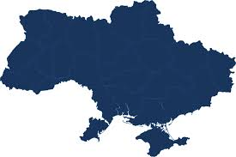
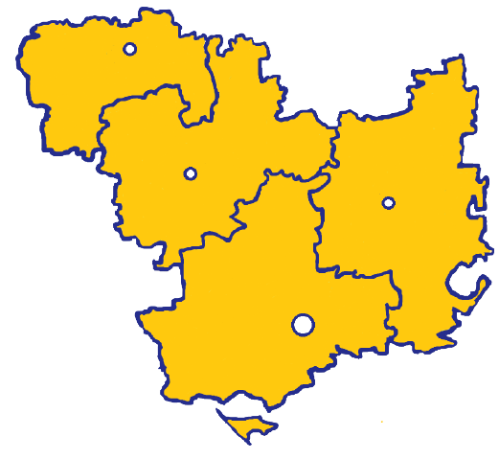
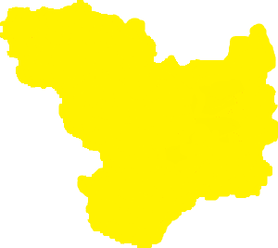
Mykolaiv Region
Total area – 24 600 of km²
Population – 1.11 mln of people
Administrative center – Mykolaiv
Access to the
Black Sea Basin
Regions
which Mykolaiv Region borders on :
Odessa, Kherson, Dnepropetrovsk, Kirovograd

Slide 3
Diversified Economy
Main sectors
of foreign investment
Structure of economy
41,9 %
Agriculture
21 %
Other
Health Care
5 %
Industry
21 %
Industry
3 %
Warehousing
41,2 %
10,1 %
Construction
7 %
13 %
Trade
Administrative services
6,8 %
7 %
13 %
Education
and Science
10 %
Public Management
Transport
Other

Slide 4






Substantial Scientific Capability and
Highly Skilled Labor Resources
67 % (531 500 of people)
economically active population
of employment age
29 000 students
16
VII place ($ 12 mln)*
among Ukrainian Regions by
innovation activities expenditures
Higher educational
institutions
(I-IV accreditation levels)
III place
among the regions of Ukraine in terms of wages
* - for 2019

Slide 5
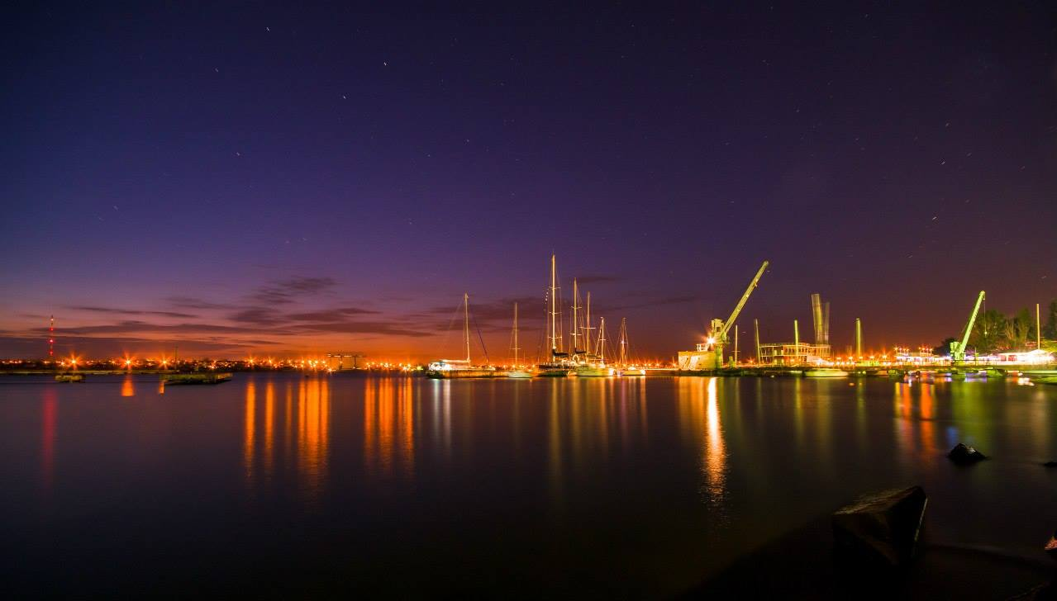







Powerful Production Potential
33,3 %
Energy
34,2 %
7,5%
Food
Industry
Others
Structure of Industry
0,9%
Light
industry
12,6 %
Metallurgy
3,9%
Mining
industry
7,6%
Engineering

Slide 6
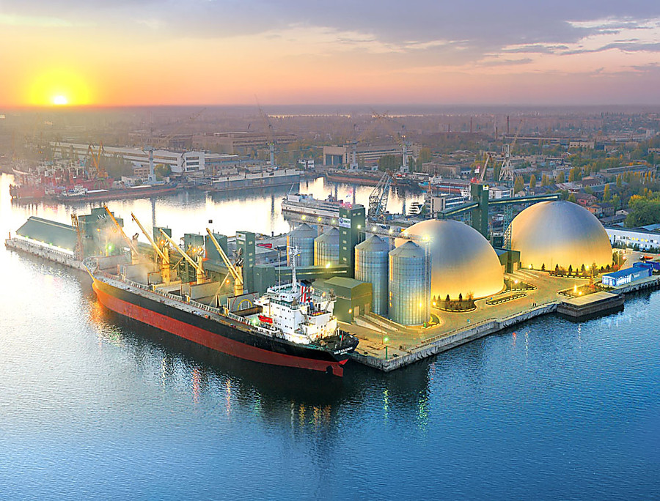

Mykolaiv Region is a leading market of Ukraine
Priorities
for investment
Raw leather
78,6 %
Alumina
100 %
Modernization and enlargement of production facilities of industrial enterprises
Development of the maritime industry, including shipbuilding
Creation and development of infrastructure of industrial parks and industrial zones
Tomato
paste
53,2%
24,4 %
Juices
Agricultural
machinery
44,0%
100 %
Gas turbines
33,8 %
Condensed milk
and cream

Slide 7
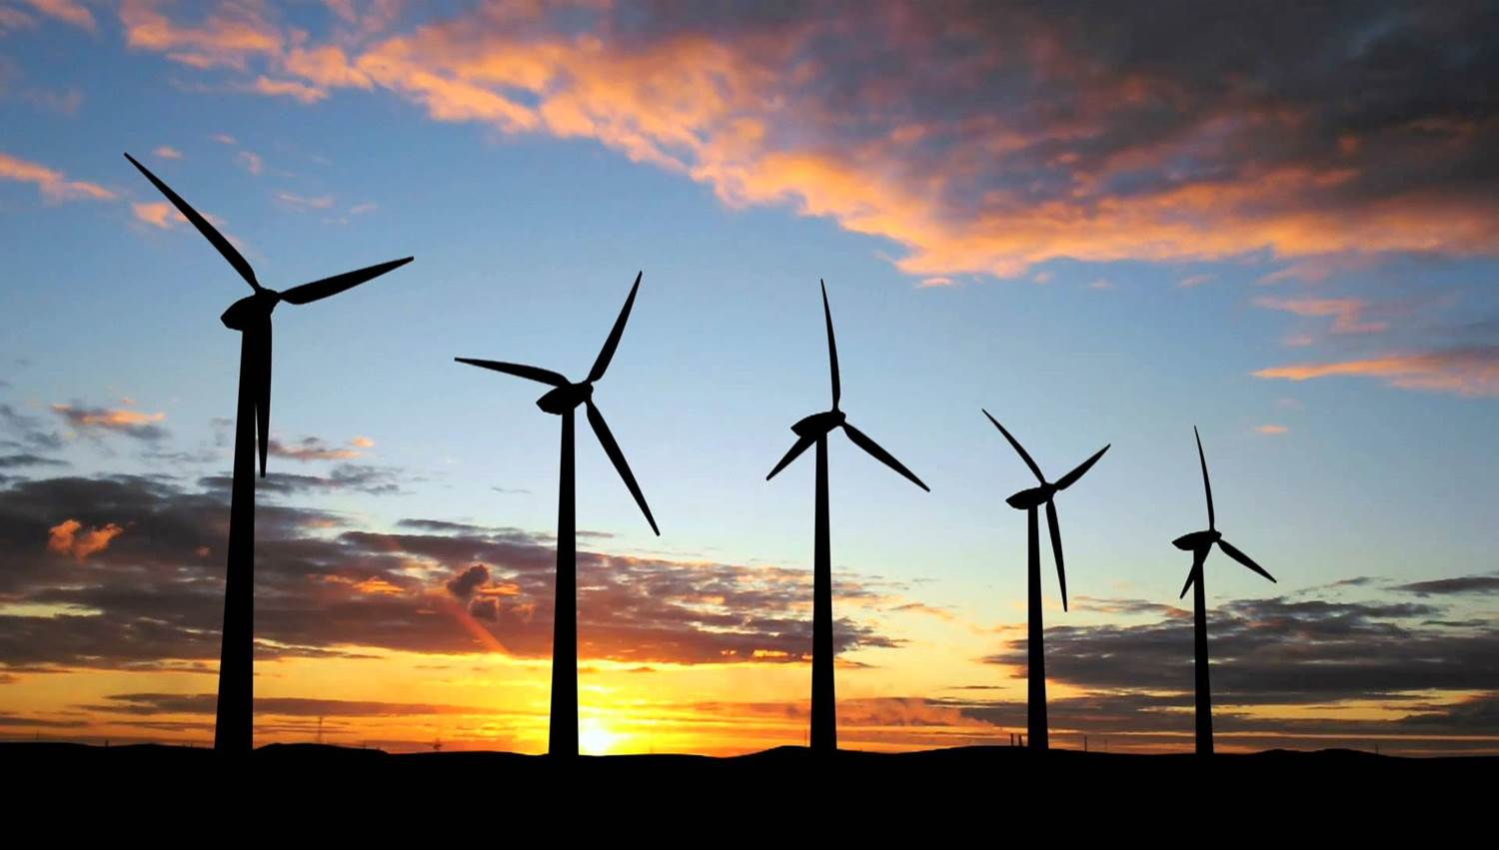

High Energy Potential
Priorities
for investment
300
mln of kWh
wind power
produced
per year
19,4
bln of kWh
nuclear power
produced
per year
Development
of alternative energy
Construction of the South-Ukraine NPP
№4 power unit
Completion of construction and
commissioning of №3 hydroelectric unit
of Tashlyk pumped storage plant
Construction of spray ponds,
reconstruction of the South-Ukraine NPP
water supply system
63
solar power
plants
(659,3 MW)
54
wind turbines
(152 MW )
ENERGY POTENTIAL
OF REGION
300
sunny days
per year
50 %
of Ukraine
solar power
potential

Slide 8







Favorable Climatic Conditions and Fertile Lands for Development of Agrarian Sector
The region produced in 2020 (tons):
Priorities
for investment
2395,6 thousand GRAINS
693,9 thousand SUNFLOWERS
566,7 thousand VEGETABLES
206,6 thousand POTATOES
Reconstruction of the South Bug irrigation system of Voznesensky and Mykolaiv districts of the Mykolaiv region
Construction and technological renovation of livestock complexes
Development of infrastructure of vegetable, fruit storages and shops for processing vegetables and fruits

Slide 9
Benefits of Geographical Location
Baltic Sea
International
Transport Routes
Minsk
Berlin
Warsaw
Prague
Kyiv
Baltic Sea – Black Sea
Bratislava
Vienna
Mykolaiv Region
Black Sea Economic
Cooperation
Budapest
Odessa
Bucharest
Black Sea
Eurasian
Sofia
Rome

Slide 10




Developed transport infrastructure
and significant transit opportunities
Priorities
for investment
3 sea ports
which are capable
of handling over 40 mln tons
of cargoes per year
Overhaul of the Pivdennobuzhsky and
Ingulsky bridges in Mykolaiv
Construction of bridge over
the Southern Bug River in Mykolaiv
Transfer to the concession of the passenger
station of the railway "Mykolaiv“
Modernization and reconstruction of
“Mykolaiv International Airport”
Electrification of the Dolynska-
Mykolaiv-Kolosivka railway line
Construction of the marine intermodal
cluster "Berezan"
“Mykolaiv
International Airport”
“Kulbakine” Airfield
720 km - railway network
within the region;
800 wagons per day –
“Mykolaiv” transport hub
cargoes handling capacity

Slide 11
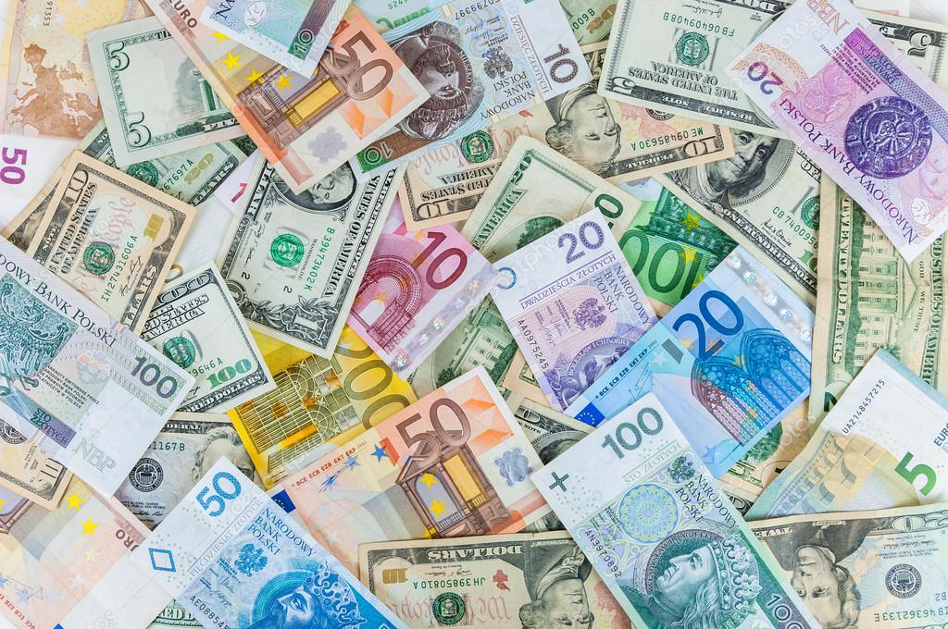





Intensive Foreign Trade Activity
$ 2,4 bln
export
of goods and services
600 enterprises of foreign
trade activity
150 countries
Leadership
in export of grains and
sunflower oil in Ukraine
Successful projects of a worldwide known companies
Positive balance
of a foreign trade
7th rank
in export of goods
in Ukraine
«Bunge» $ 280 mln
«PepsiCo» $ 200 mln
«Cofco»
$ 75 mln
«Dyckerhoff»
$ 56 mln
«Scatec Solar»
$ 135 mln
«Posco»
$ 65 mln

Slide 12
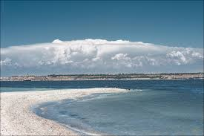
Great Tourist Potential
2 mln m³
of therapeutic
mud
Priorities
for investment
140 km
length of sea
and estuary coastline
Development of local resort on the
territory of Koblevo
United Territorial Community
Development of tourist infrastructure along tourist routes
"Tourist magnets of Mykolayiv region“
Ecological and green tourism is the basis for the recovery of the rural economy
Creation of tourist information centers
3
resort areas:
Koblevo
Rybakovka
Оchakov
141 objects
of natural reserve fund
with total area of
75 000 ha

Slide 13
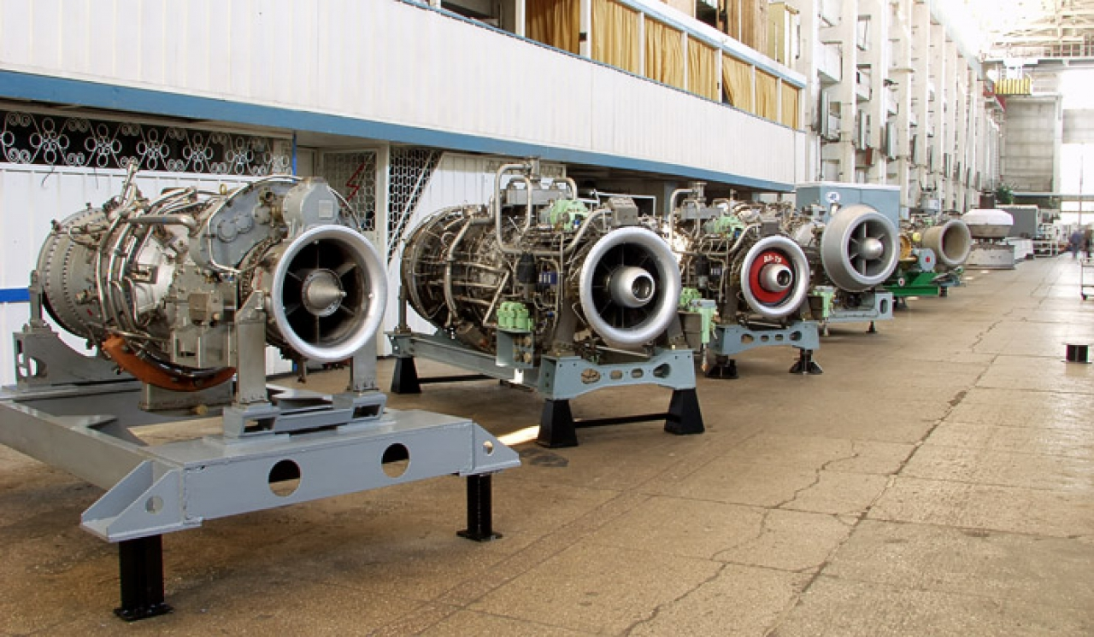
Mykolaiv Region is open to cooperation
To implement investment projects
Industry
More than
200
Agriculture
land plots
Renewable energy
4, 5
total
area
thousand
ha
Education and IT technology

Slide 14
Entrepreneurship Support Regional Fund
of Mykolaiv Region www.consult-center.
com.ua
Mykolaiv
City Council
www.mkrada.gov.ua
“Business Support
Center” LLC www.biz.mk.ua
Institutions which support investors:
Mykolaiv Regional
State Administration
www.mk.gov.ua
Mykolaiv Regional
Chamber of Commerce
and Industry
www.rtpp.com.ua
“Mykolaiv Development Agency”
www.mda.mk.ua
Local Development
Agency of Koblevo
United Territorial
Community
www.kamr.org.ua

Slide 15
Mykolaiv Region
is open for cooperation!
Mykolaiv Regional State Administration
22, Admiralskaya Str., Mykolaiv, Ukraine, 54001,
Tel./fax: +38 (0512) 37 01 36
E-mail: cancelar@mk.gov.ua
www.mk.gov.ua

