Slide 1
Joint Operational Programme
Black Sea Basin
Main elements

Slide 2

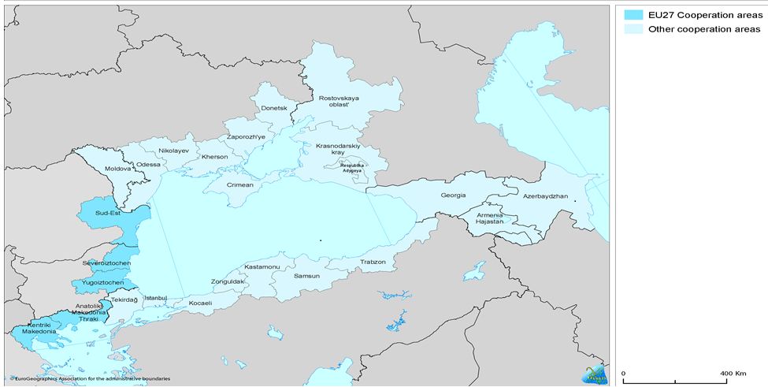
Black Sea Basin Programme
2 programming exercises:
  2007-2013 – completed
  2014-2020 - ongoing
Bulgaria: 2 regions of Severoiztochen, Yugoiztochen;
Grecia: regions of Kentriki Makedonia, Anatoliki Makedonia Thraki;
Romania: region of South-East;
Turcia: regions of TR10 (İstanbul), TR21 (Tekirdağ, Edirne, Kırklareli), TR42 (Kocaeli, Sakarya, Düzce, Bolu, Yalova), TR81 (Zonguldak, Karabük, Bartın), TR82 (Kastamonu, Çankırı, Sinop), TR83 (Samsun, Tokat, Çorum, Amasya) and TR90 (Trabzon, Ordu, Giresun, Rize, Artvin, Gümüşhane);
Ucraina*: Odesa, Mykolaiv, Kherson, Zaporosh’ye and Donetsk Oblasts, Crimea Republic, Sevastopol;
Rep. Moldova, Georgia, Armenia: whole country.
*General EU restrictions on cooperation in Crimeea and Sevastopol regions are applicable to CBC, as provided for in the ENI CBC Programming document

Slide 3

Budget
2007-2013
ENPI Budget: 17 mil. → 28 mil. Euro
IPA Budget: 7 mil. Euro
Total EU contribution (ENPI+IPA): 35 mil. Euro
plus national co-financing (10%)
2014-2020
ENI Buget : 39 mil. Euro
IPA Buget : 10 mil. Euro
Total EU contribution (ENI+IPA): 49 mil. Euro
plus national co-financing (10%)

Slide 4
Priorities
2007-2013 | 2014-2020
ECONOMIC AND SOCIAL DEVELOPMENT
1.1 Strengthening accessibility and connectivity | 1.1 Jointly promote business and entrepreneurship in tourism and cultural sectors
1.2 Creation of tourism networks | 1.2 Increase cross-border trade opportunities and modernisation in the agricultural and connected sectors
1.3 Creation of administrative capacity | -
ENVIRONMENTAL PROTECTION
2.1 Address common challenges in the environmental protection of river and maritime systems | 2.1 Improve joint environmental monitoring
2.2 Conservation and environmental protection for protected natural areas | 2.2 Promote common awareness-raising and joint actions to reduce river and marine litter
2.3 Innovation in technologies and management of solid waste and wastewater management systems | -
PEOPLE-TO-PEOPLE COOPERATION
3.1 Promoting cultural networking and educational exchange | -

Slide 5
Eligibility
Legal status | regional, local public authority or national public authority bodies governed by public law non-profit organisations (NGO)
Partnership | Minimum - 3 partners from different countries Maximum - 6 partners including the Lead Partner
 | Partners - from at least 1 EU MS and 1 CBC partner country
 | Participation of Turkish partners – in projects with at least 1 partner from a EU MS and 1 partner from a CBC partner country
Size of grants | Max. 1 500 000 Euro
Project duration | Max. 30 months
Notes:
A) regional, local or, if necessary for the project purpose, national public authority - PLEASE NOTE that although national authorities are not excluded, priority will be given to local and/or regional authorities, civil society organisations, chambers of commerce, and the academic and educational community; as well as other eligible actors.
B) bodies governed by public law - have all of the following characteristics:
(b.1) they are established for the specific purpose of meeting needs in the general interest, not having an industrial or commercial character;
(b.2) they have legal personality; and
(b.3) they are financed, for the most part, by the State, regional or local authorities, or by other bodies governed by public law; or are subject to management supervision by those authorities or bodies; or have an administrative, managerial or supervisory board, more than half of whose members are appointed by the State, regional or local authorities, or by other bodies governed by public law;

Slide 6

Results
2007-2013
60 projects
More information:
http://blacksea-cbc.net/wp-content/uploads/2017/11/2017_annual-brochure.pdf
2014-2020
55 projects
24 under implementation phase
More information:
https://blacksea-cbc.net/projects/our-projects-2014-2020/
31 under contracting phase

Slide 7
www.blacksea-cbc.net
www.facebook.com/BlackSeaBasin
Managing Authority
blacksea-cbc@mlpda.ro

